Slide 1

Event Hub on Azure
Abdul Rasheed Feroz Khan
Director – Code$izzler
Twitter - @TechFero | @CodeSizzler
www.codesizzler.com
#CodeSizzler | #EventHub

Slide 2

Abdul Rasheed Feroz Khan
Founder & Director – CodeSizzler
Microsoft MVP – Azure
7+ years of experience in Training
Azure – IoT – Machine Learning – Cognitive Services – Bot – Xamarin – Big Data
#CodeSizzler | #EventHub
#csharpconf2017, @TechFero
#csharpconf2017, @TechFero Machine Learning with Azure

Slide 3
Creating an Event Hub

Slide 4
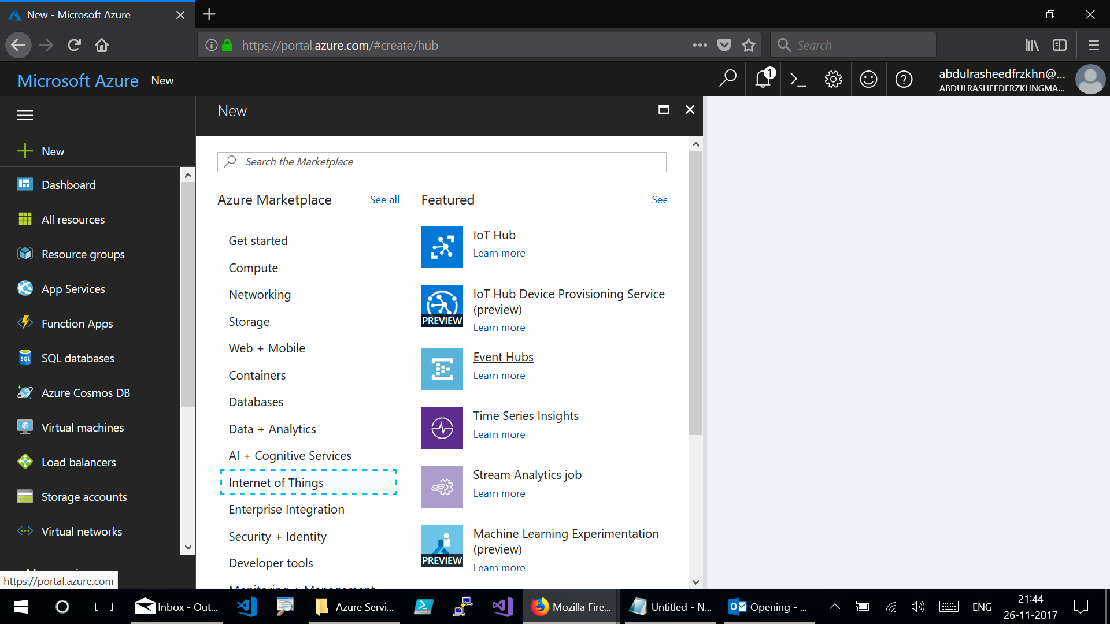
Notes:
Go for New → Internet of Things → Event Hubs

Slide 5
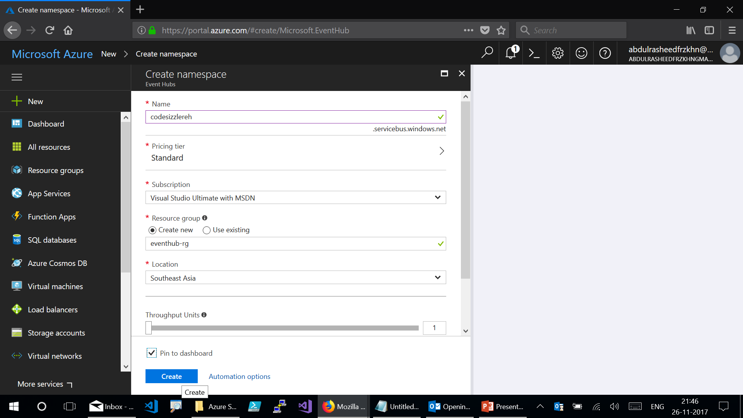
Notes:
Create namespace:
Give the namespace
Select the pricing tier
Select the subscription plan
Create or use an existing resource group
Select the DC location
Throughput units

Slide 6
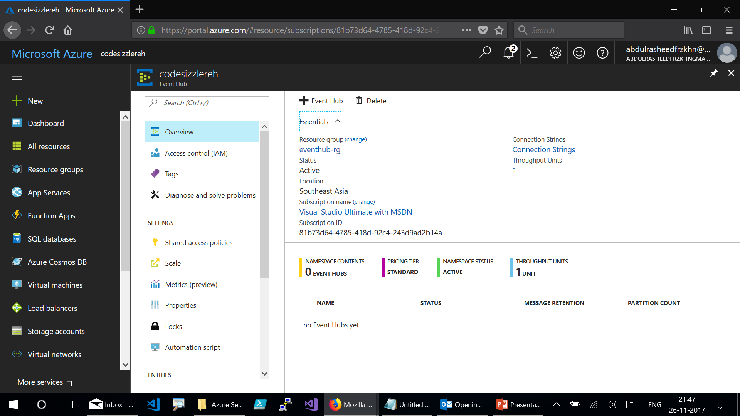

Slide 7
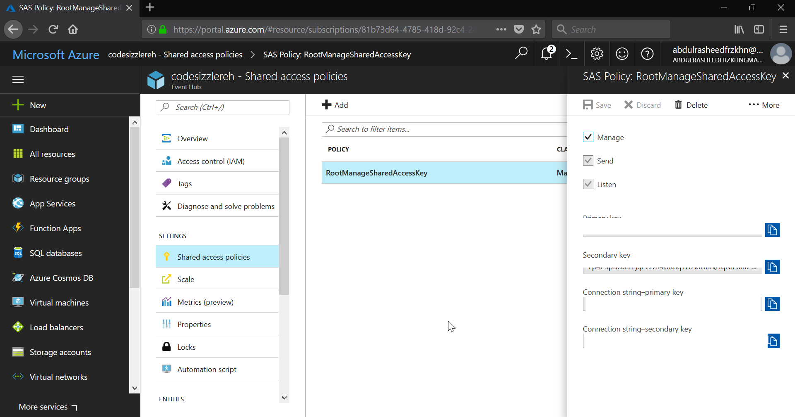
Notes:
Get the Shared Access Policies:
Settings → Shared Access Policies → RootManagerSharedAccessKey → Connection String-Primary Key

Slide 8
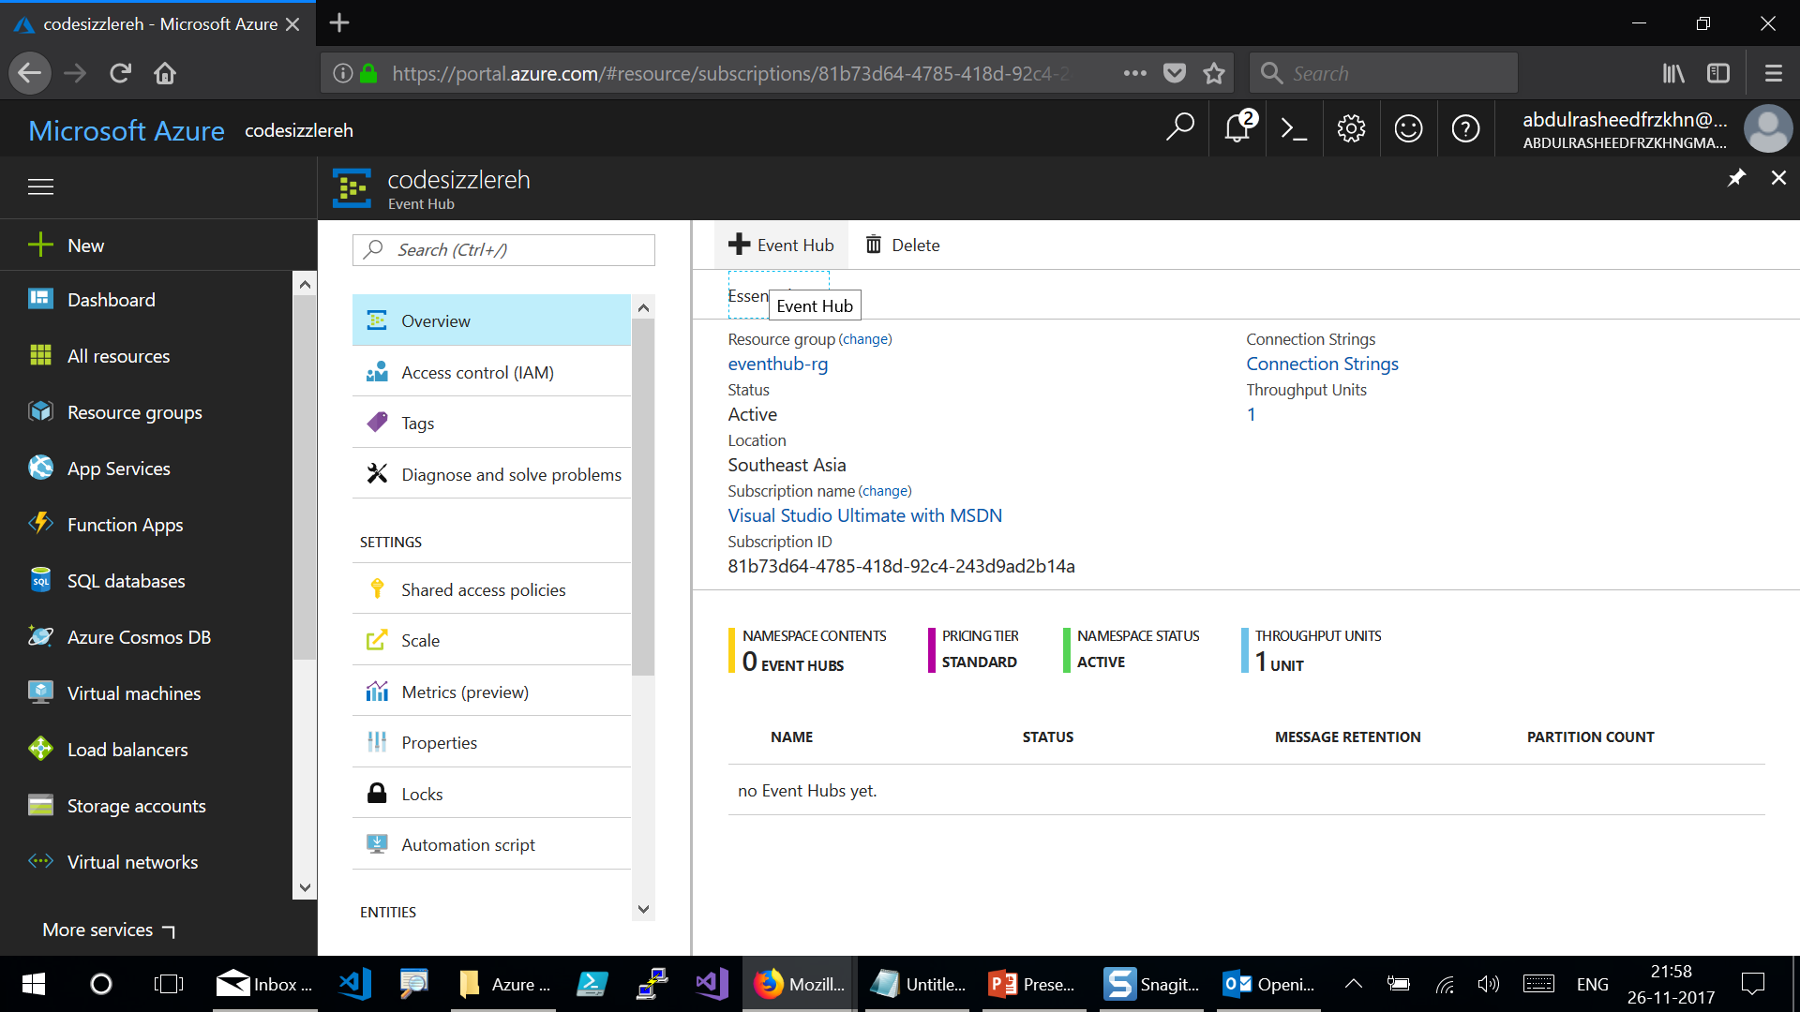
Notes:
Create an Event Hub by Clicking on “+Event Hub” – List out the namespace and click on create at the next screen.

Slide 9
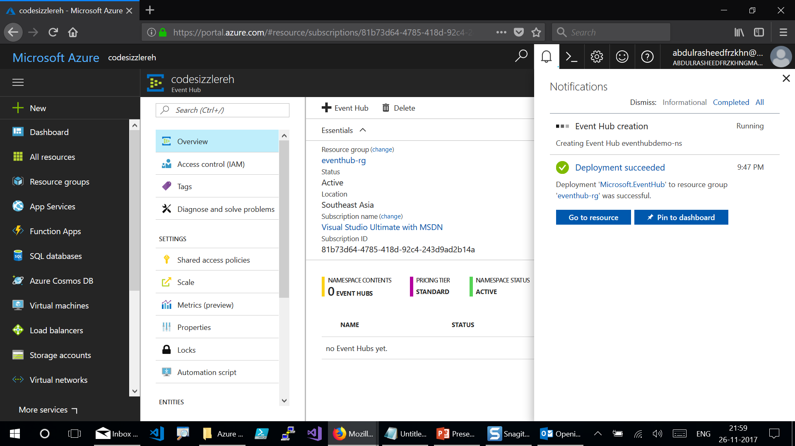
Notes:
Here goes your Event Hub created

Slide 10
.NET Core Console Application to send a set of messages

Slide 11
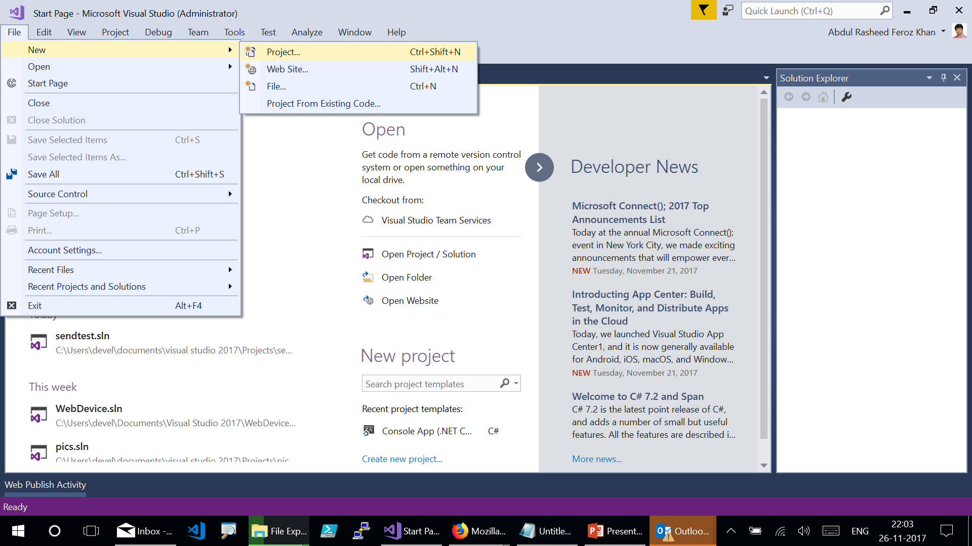
Notes:
Run Visual Studio 2017 as Admin and click on File → New → Project

Slide 12
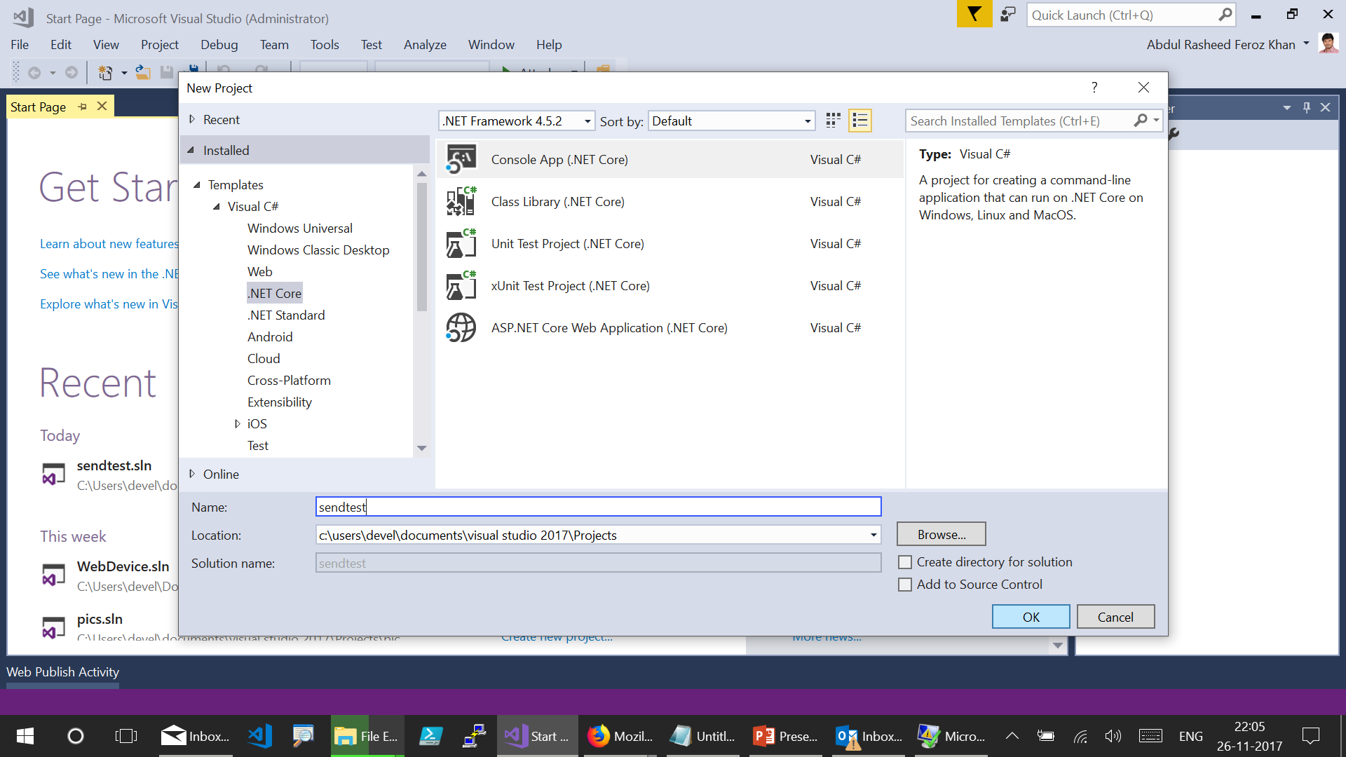
Notes:
Go for Visual C# under Templates - .Net Core – Console App - Name your project – select the location – Click on OK.

Slide 13
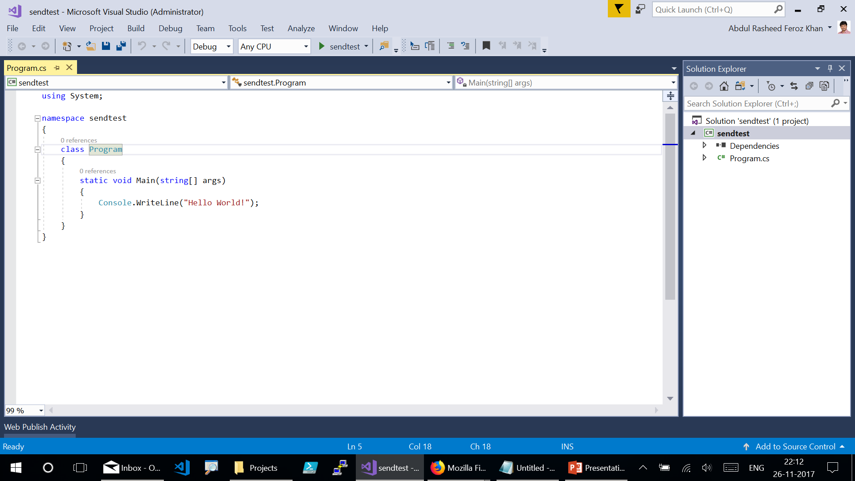
Notes:
Here goes your project created and lands up with the above page as shown.

Slide 14
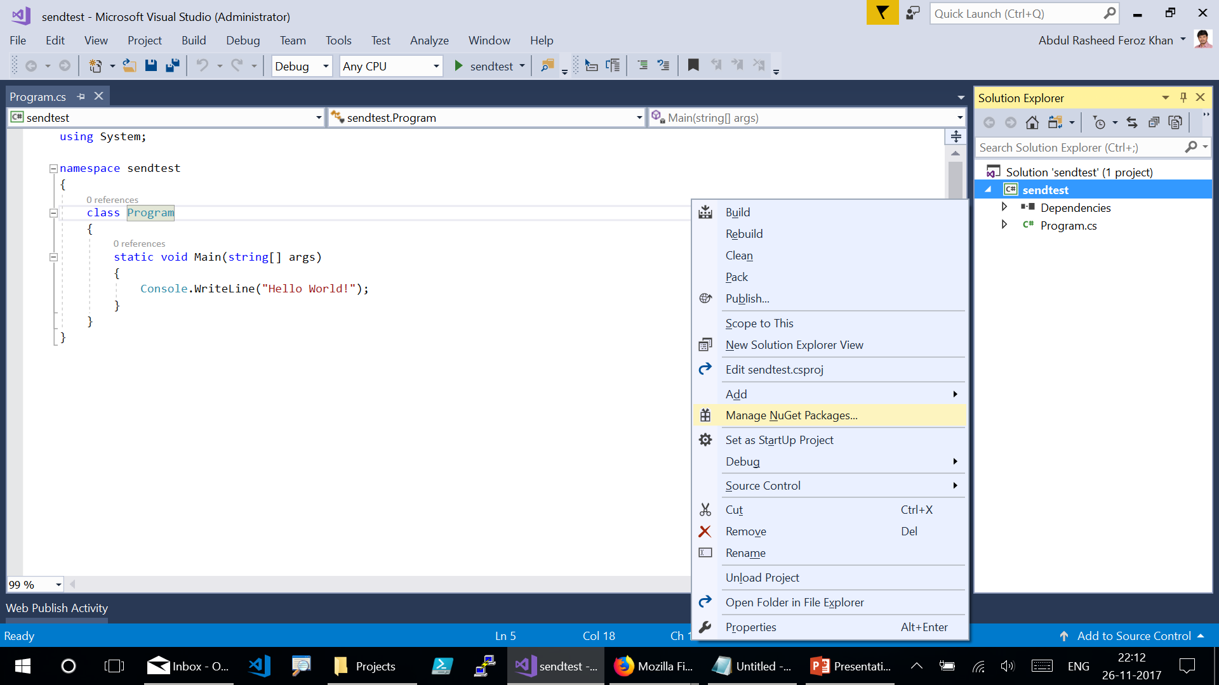
Notes:
Right click the project and add the Nuget packages by clicking on “Manage NuGet Packages”.

Slide 15
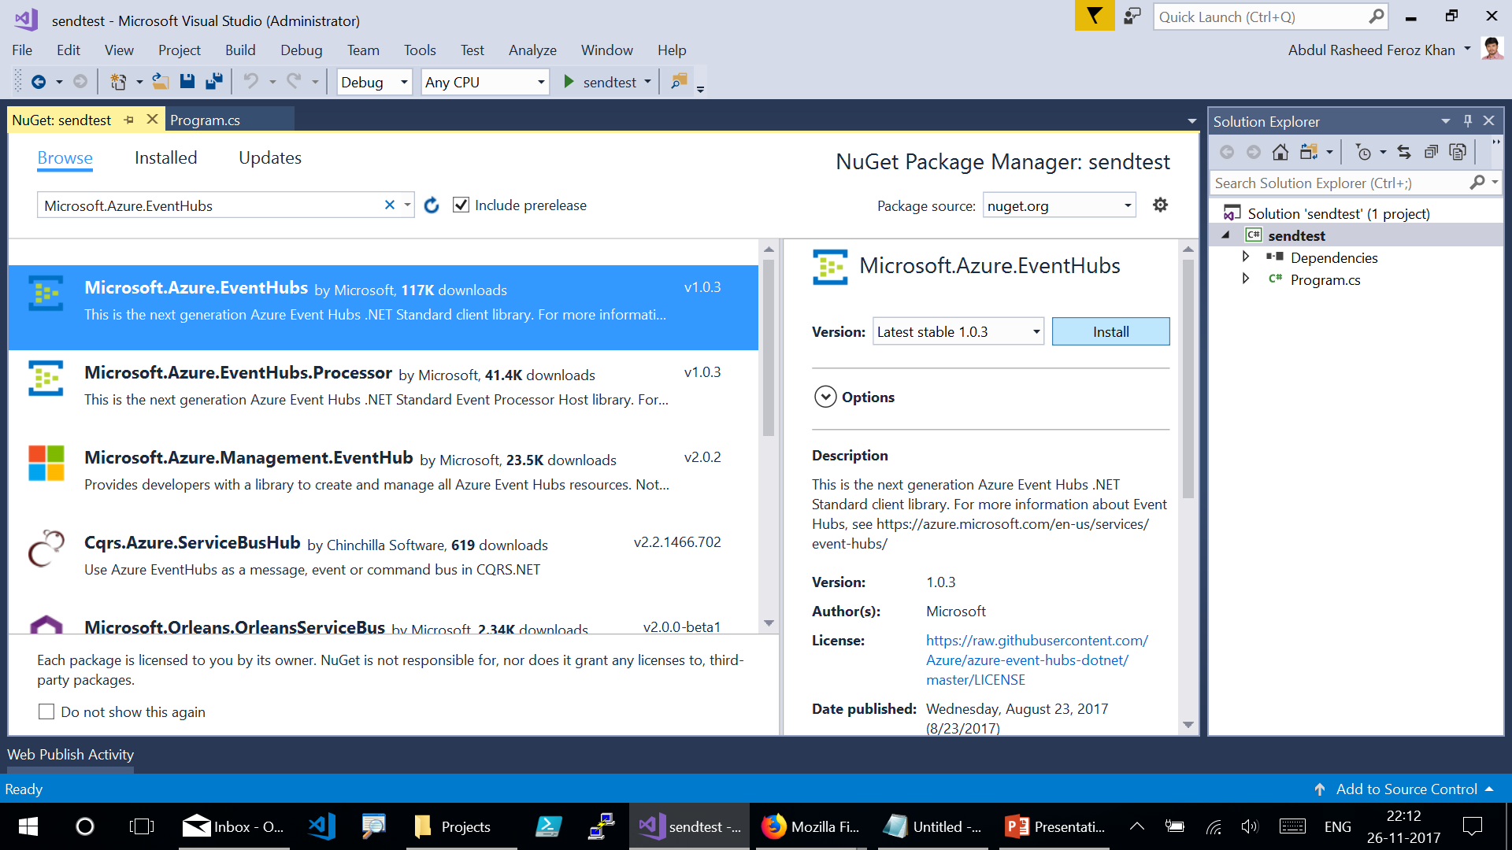
Notes:
Go for Browse and search for “Microsoft.Azure.EventHubs” – Click on Install.

Slide 16
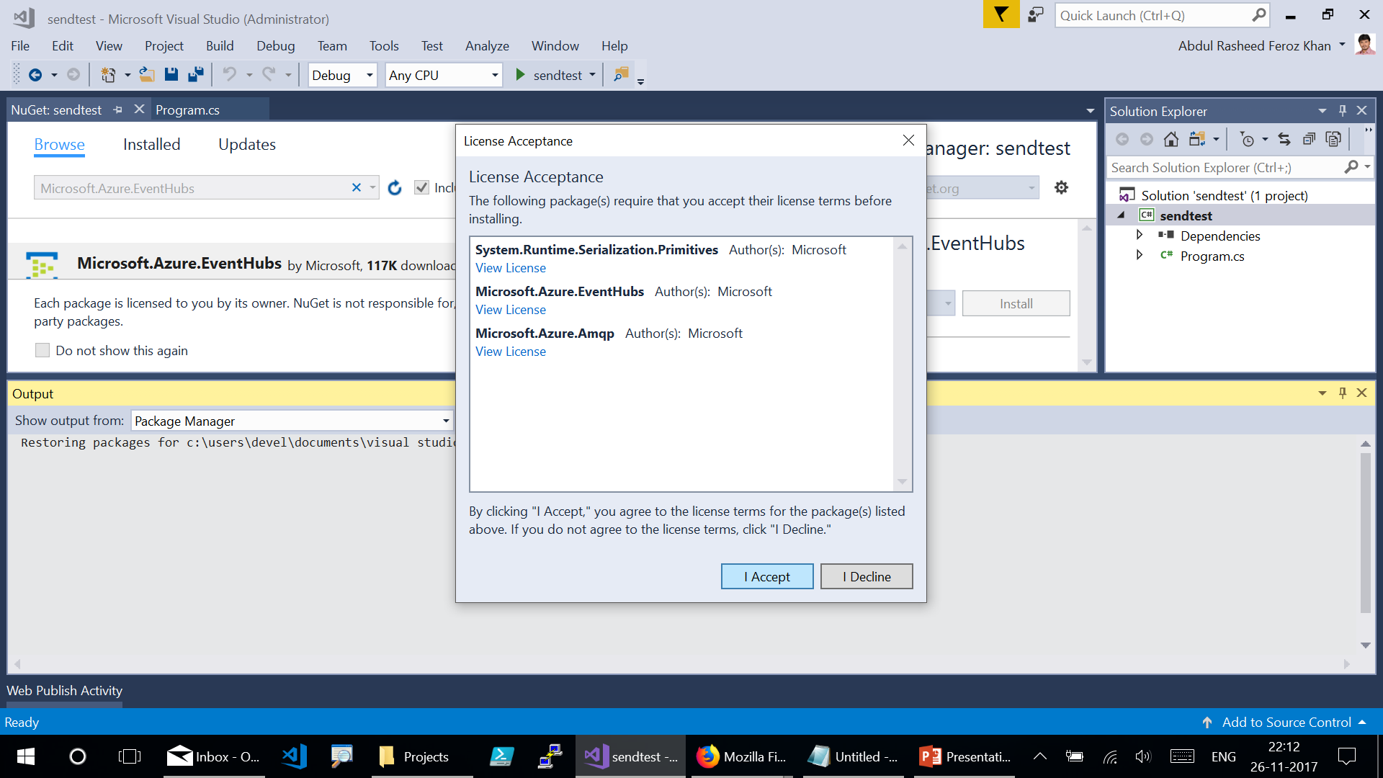
Notes:
Click on “I Accept” to install the NuGet package.

Slide 17
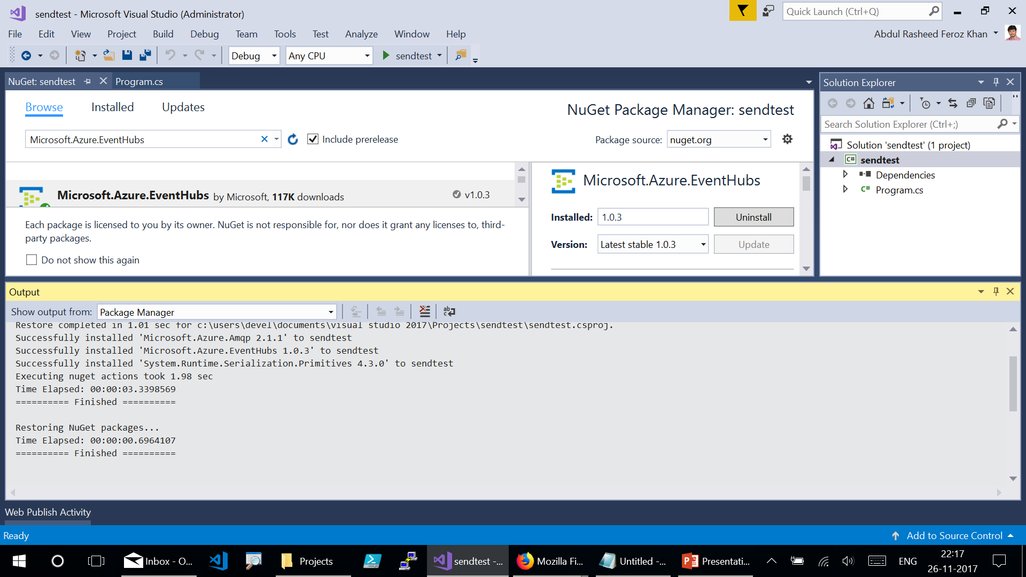
Notes:
Here goes the NuGet package installed.

Slide 18
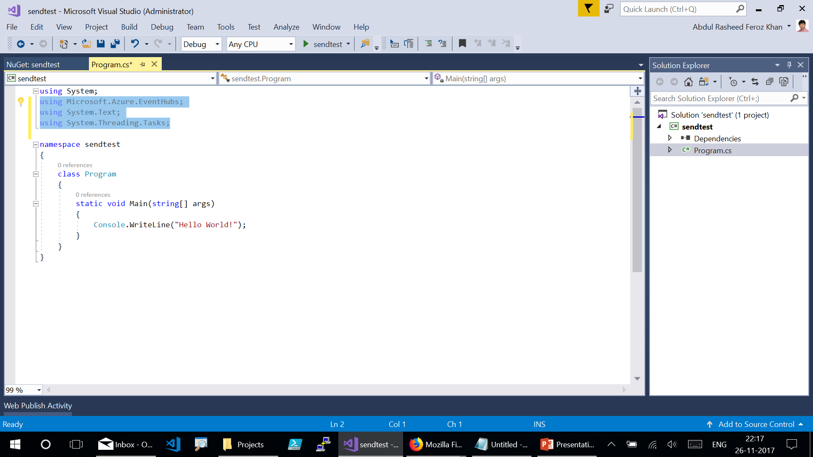
Notes:
Go for Program.cs and add the below Using statements:
using Microsoft.Azure.EventHubs;
using System.Text;
using System.Threading.Tasks;

Slide 19
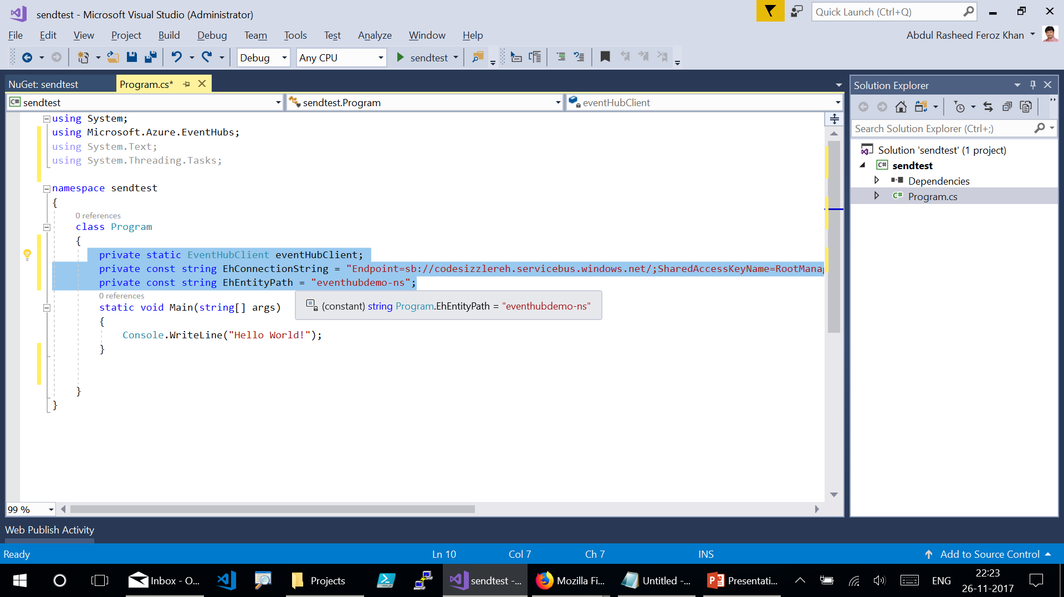
Notes:
Add constants to the Program class for the Event Hubs connection string and entity path (individual event hub name). Replace the placeholders in brackets with the proper values that were obtained when creating the event hub. Make sure that the {Event Hubs connection string} is the namespace-level connection string, and not the event hub string.
Code link : https://codeshare.io/G7PNOj
Code Snippet:
private static EventHubClient eventHubClient;
private const string EhConnectionString = "{Event Hubs connection string}";
private const string EhEntityPath = "{Event Hub path/name}";

Slide 20
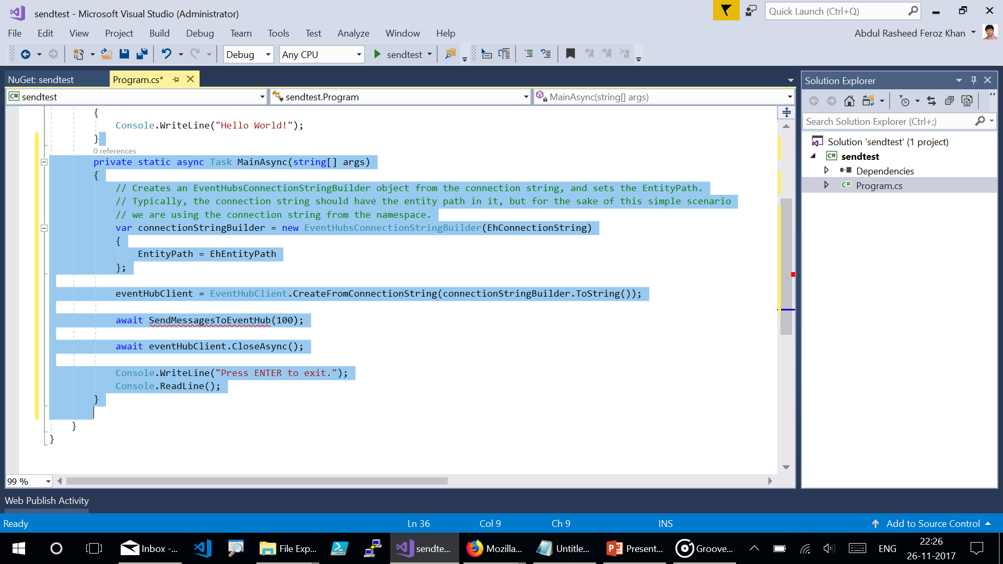
Notes:
Add a new method named MainAsync to the Program class, as follows
Note: You will be getting a red underlined bug mark after pasting the code, don’t worry about it for now.
Code Link - https://codeshare.io/5PBbAE
Code Snippet:
private static async Task MainAsync(string[] args)
{
// Creates an EventHubsConnectionStringBuilder object from the connection string, and sets the EntityPath.
// Typically, the connection string should have the entity path in it, but for the sake of this simple scenario
// we are using the connection string from the namespace.
var connectionStringBuilder = new EventHubsConnectionStringBuilder(EhConnectionString)
{
EntityPath = EhEntityPath
};
eventHubClient = EventHubClient.CreateFromConnectionString(connectionStringBuilder.ToString());
await SendMessagesToEventHub(100);
await eventHubClient.CloseAsync();
Console.WriteLine("Press ENTER to exit.");
Console.ReadLine();
}

Slide 21
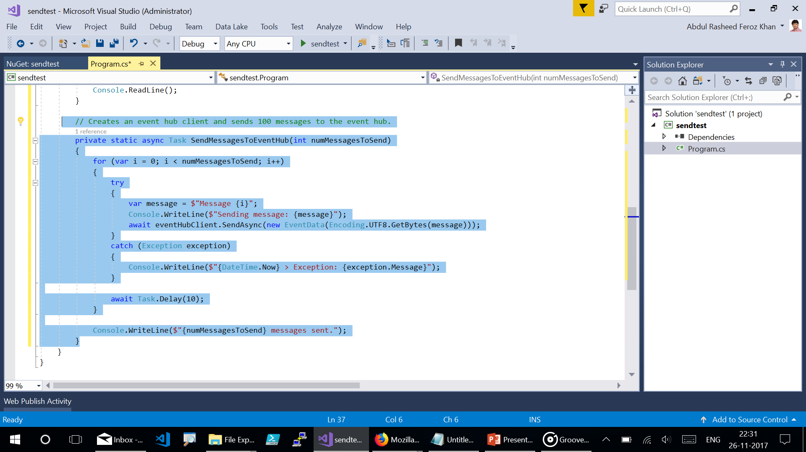
Notes:
Add a new method named SendMessagesToEventHub to the Program class, as follows:
Code Link - https://codeshare.io/2E6Ob8
Code Snippet:
// Creates an event hub client and sends 100 messages to the event hub.
private static async Task SendMessagesToEventHub(int numMessagesToSend)
{
for (var i = 0; i < numMessagesToSend; i++)
{
try
{
var message = $"Message {i}";
Console.WriteLine($"Sending message: {message}");
await eventHubClient.SendAsync(new EventData(Encoding.UTF8.GetBytes(message)));
}
catch (Exception exception)
{
Console.WriteLine($"{DateTime.Now} > Exception: {exception.Message}");
}
await Task.Delay(10);
}
Console.WriteLine($"{numMessagesToSend} messages sent.");
}

Slide 22
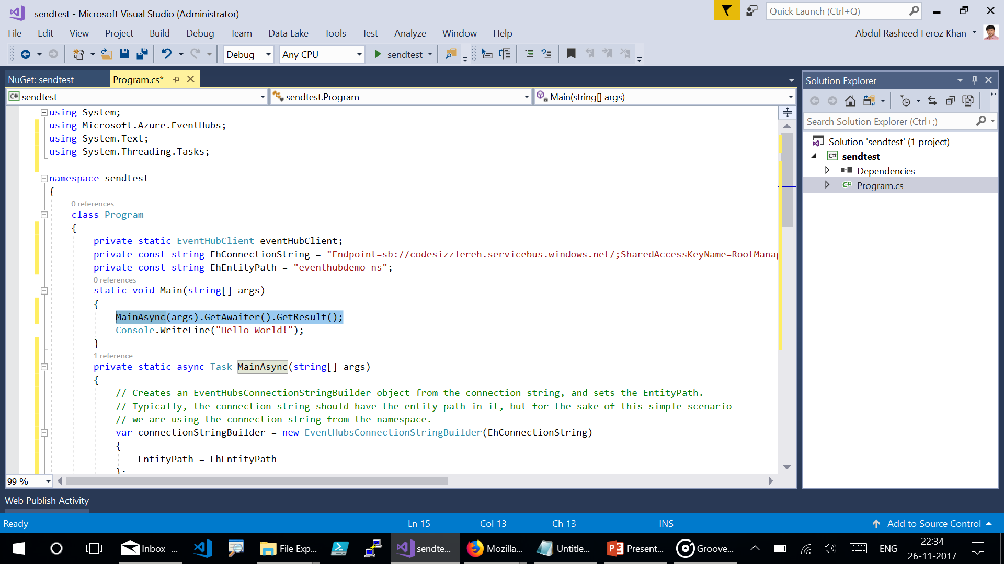
Notes:
Add the following code to the Main method in the Program class.
Code Link - https://codeshare.io/aYyjBN
Code Snippet:
MainAsync(args).GetAwaiter().GetResult();

Slide 23
https://codeshare.io/2Wmrpv
Notes:
Get the complete code for Program.cs from the above link for reference:

Slide 24
Press Ctrl + F5 to run the program

Slide 25
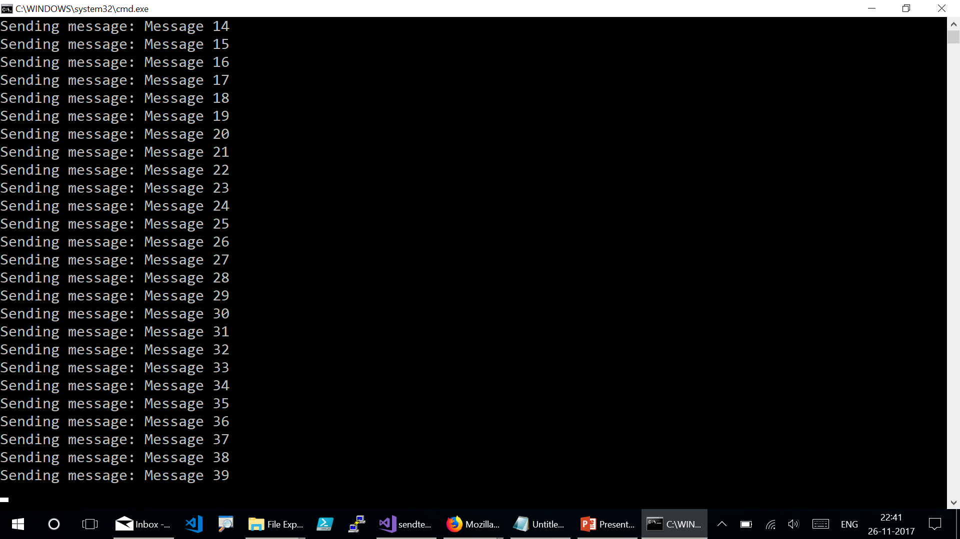
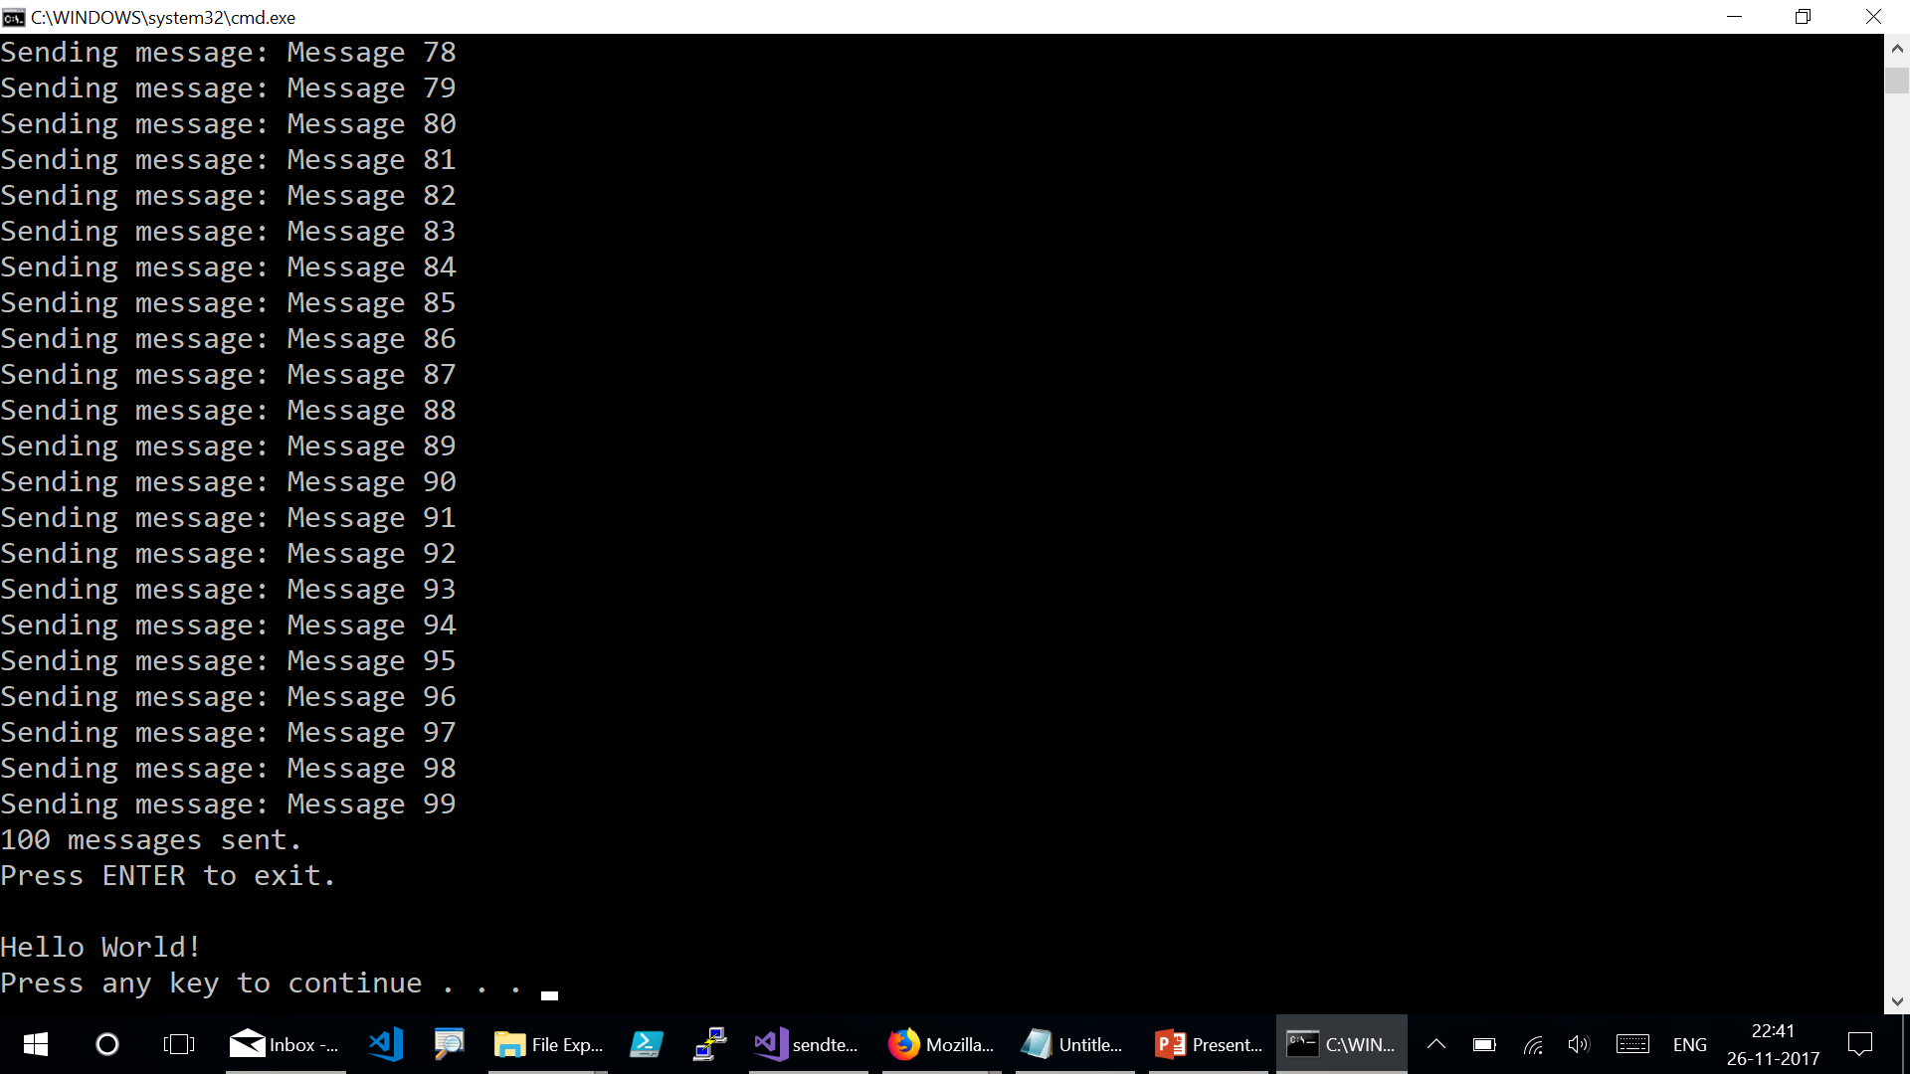
Notes:
Press “Enter” to exit from the output window.

